Slide 1
SYSTEM DESIGN TASKS
By Tavishi Jaglan

Slide 2
Objectives
Design system architecture to deploy this ML Model in production.
How do you perform canary build?
What should be the strategy for ML Model Monitoring?
How do you perform load and stress testing?
How do you track, monitor and audit ML training?
Design framework for continuous delivery and automation of machine learning tasks.

Slide 3
System architecture to deploy this ML Model in production

Slide 4
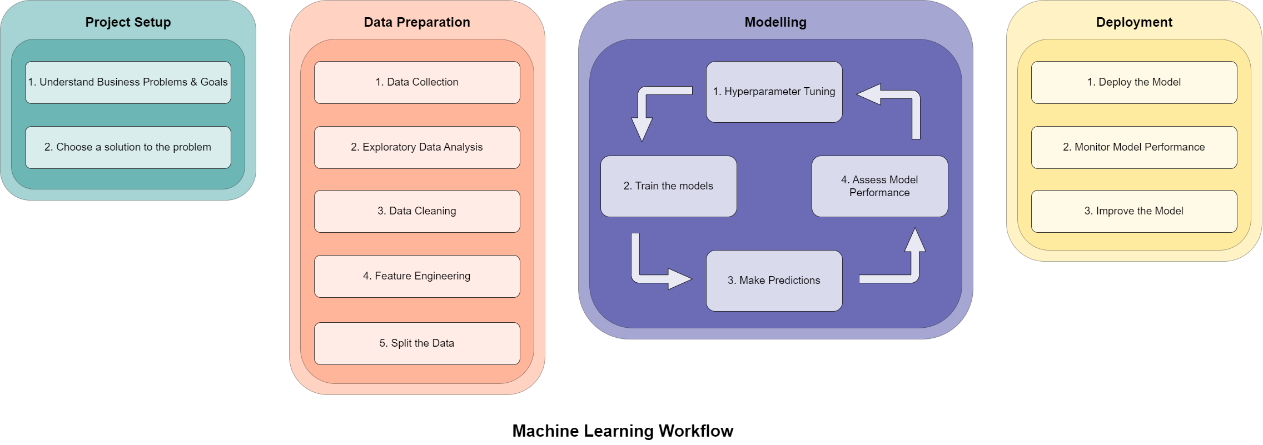
Machine Learning Workflow

Slide 5
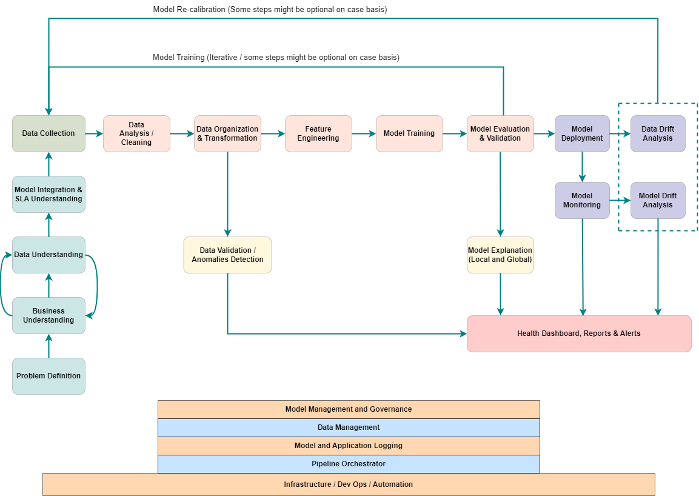
Real World ML Process

Slide 6
How do you perform canary build?

Slide 7
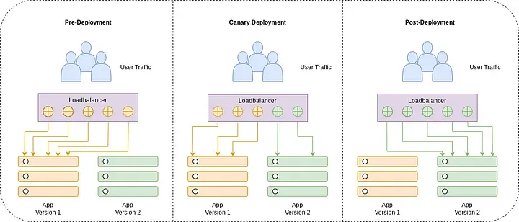
Canary Build
A canary build is a deployment strategy that releases a new version of software to a limited audience or subset of servers before a full-scale deployment.

Slide 8
What should be the strategy for ML Model Monitoring?

Slide 9
Strategy for ML Model Monitoring
Model Performance Monitoring
Versioning and Model Drift Analysis
Regular Alerting and Reporting
Logging and Auditing
Regular Retraining
Feature Importance Tracking
Robustness Testing
CI/CD Monitoring
Stress and Load Testing
Resource Utilization Monitoring
Security Monitoring
Visualization and Dashboards
Feedback Loops
Business Impact Evaluation

Slide 10
Model Monitoring Tools
Experimental Tracking Tools: MLflow, Weights & Biases (WandB)
Data Versioning Tool: DVC (Data Version Control) Load Testing Tools: Locust, Azure Load Testing Data Drift Tools: Evidently AI, Vertex AI, Amazon SageMaker Model Monitor CI/CD Tools: Cloud Build, GitHub Actions, Gitlab Pipelines, Kubernetes
Logging Tools: Google Cloud Logging, Splunk, Amazon CloudWatch Logs, Azure Monitor Logs Auto Management Tools: Vertex AI, AWS SageMaker, Azure Machine Learning Orchestration Tools: Apache Airflow, Kubeflow Pipelines, Google Cloud Composer, AWS Step Functions, Azure Data Factory
Monitoring and Alerting Tools: Prometheus, Grafana, Datadog, Google Cloud Monitoring, AWS CloudWatch, Azure Monitor

Slide 11
How Do you perform the load and stress Testing ?

Slide 12
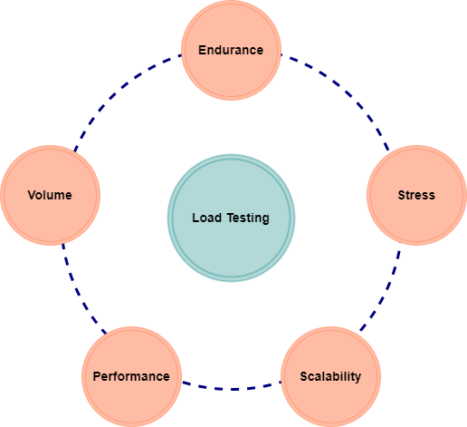

Load Testing and Stress Testing
Load Testing
Load testing is conducted to evaluate the system's behavior under expected load conditions
The goal is to ensure that the application can handle the anticipated user traffic and workload without performance degradation.
Stress Testing
Stress testing is designed to evaluate the system's robustness and resilience under extreme conditions beyond normal operational limits.
It helps identify the breaking point or failure threshold of the system.

Slide 13
How do you track, monitor and audit ML training?

Slide 14
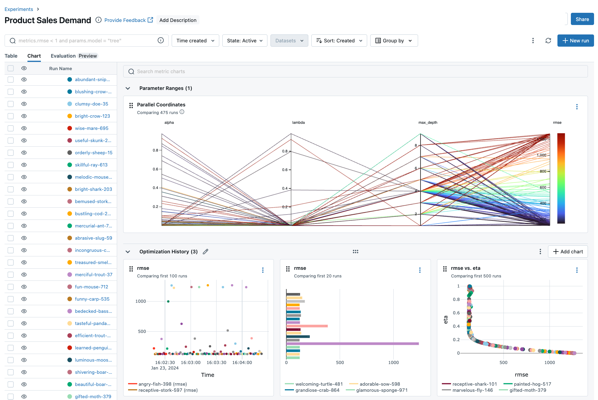
Tracking, Monitoring and Auditing of ML Training
Tracking involves recording information throughout the training process.
Monitoring focuses on analyzing the tracked data to identify problems or areas for improvement. Tools like Mlflow, WandB can visualize metrics and help you spot anomalies.
Auditing involves a more formal examination of the training process to ensure compliance with regulations or internal standards.

Slide 15
Design framework for continuous delivery and automation of machine learning tasks.

Slide 16
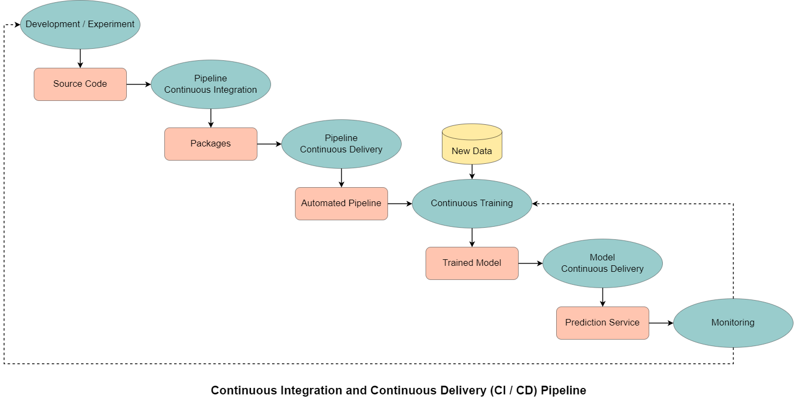
Continuous Integration and Continuous Delivery Pipeline

Slide 17
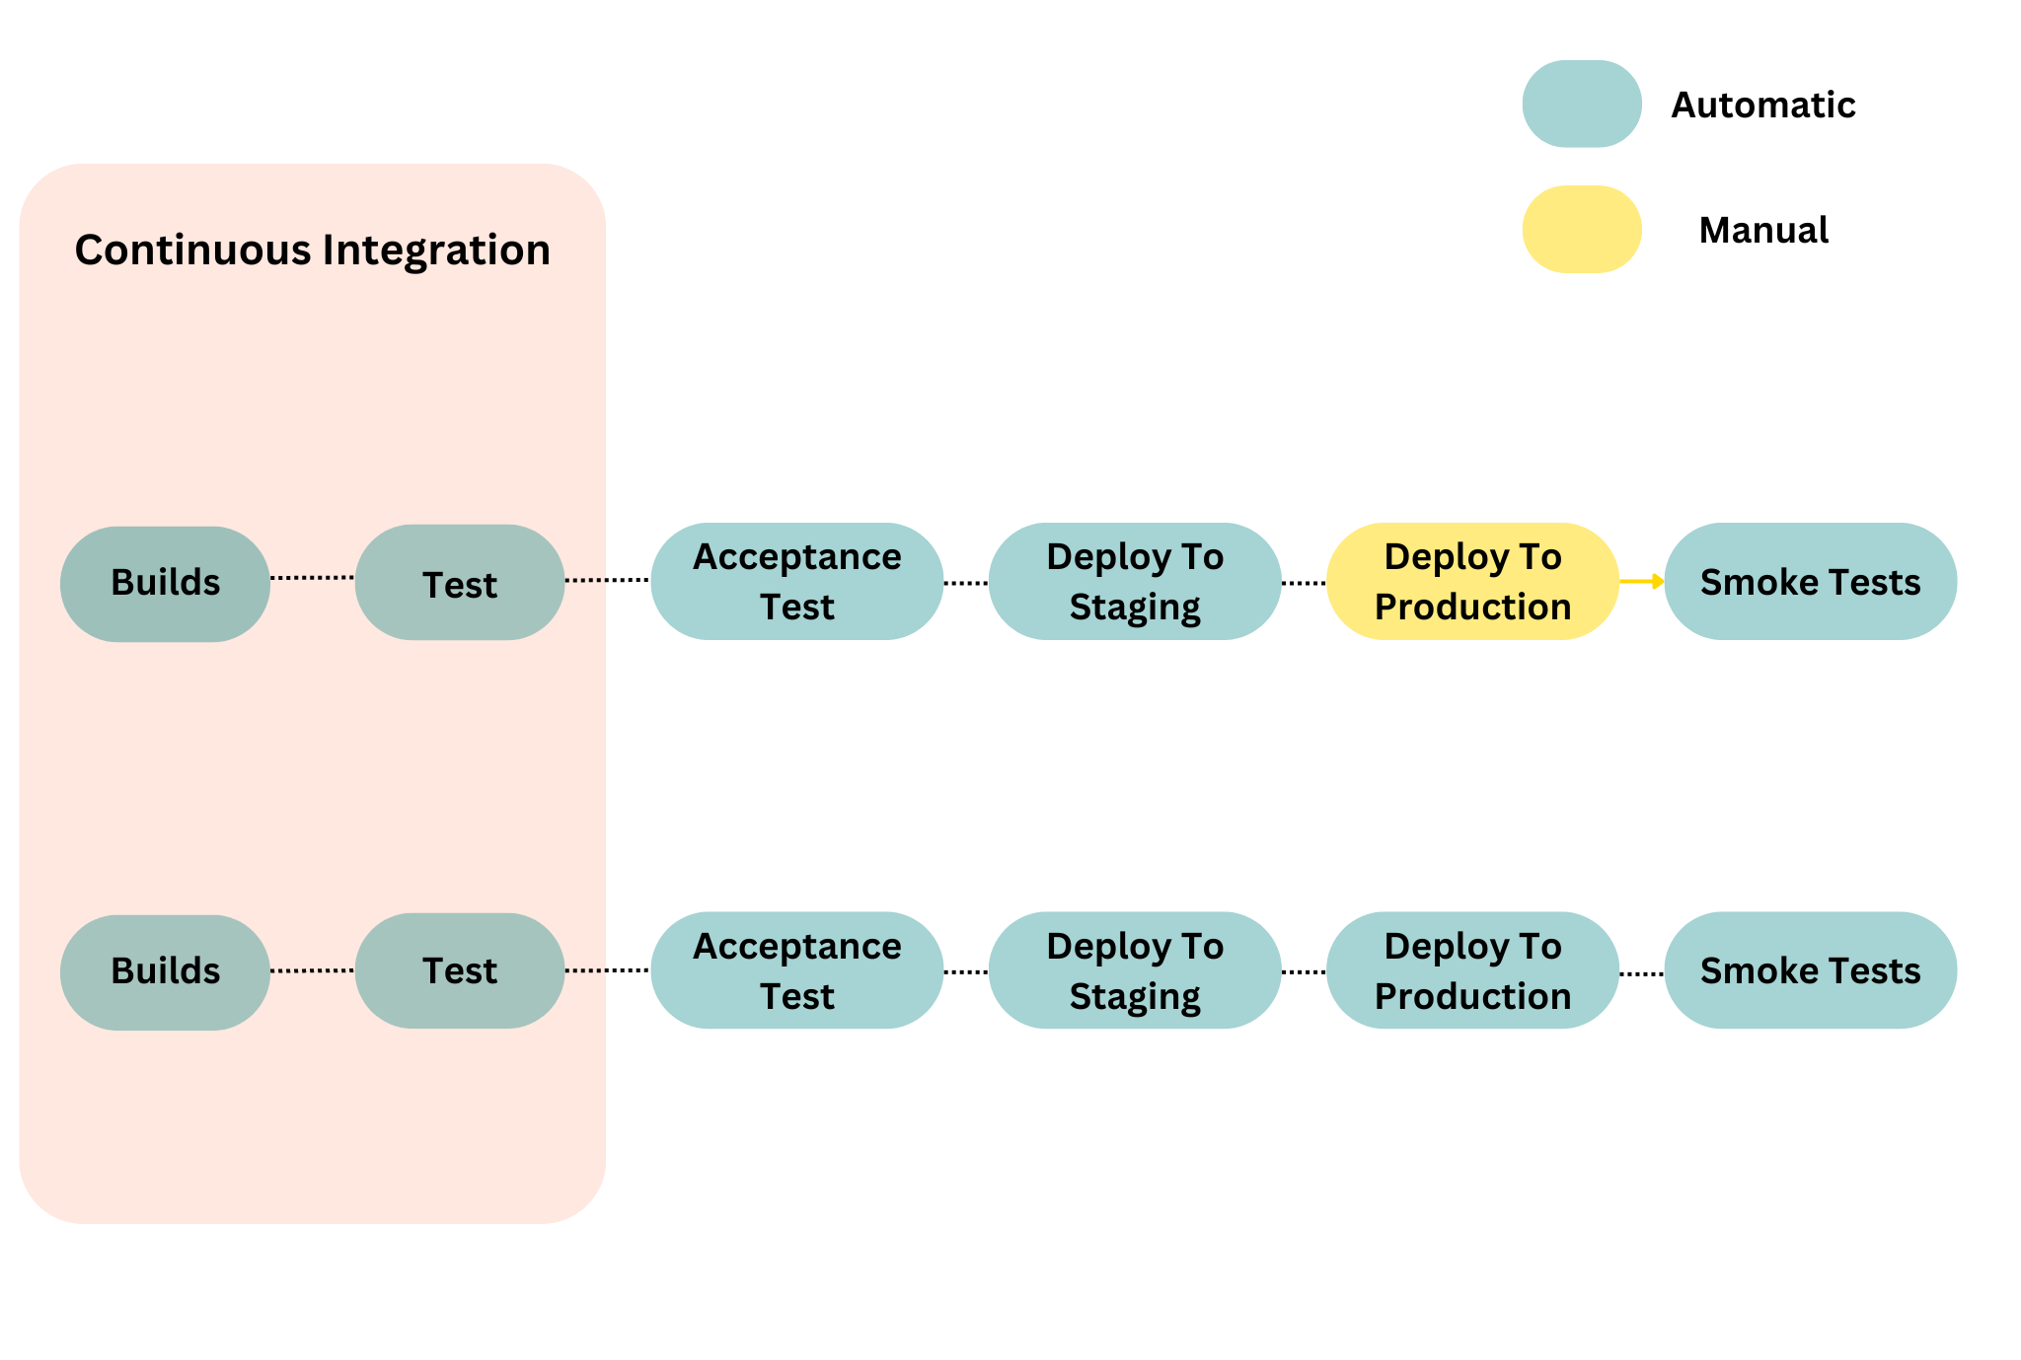
Automatic and Manual CI/CD Pipeline

Slide 18
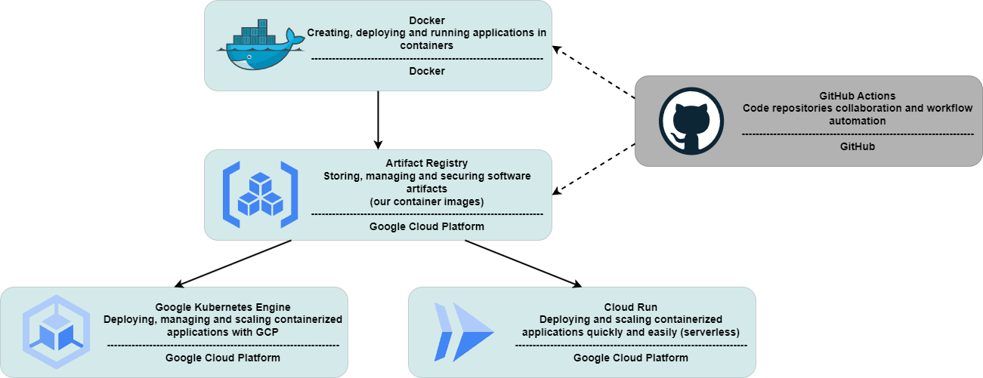
How I deployed the model to Google Cloud

Slide 19
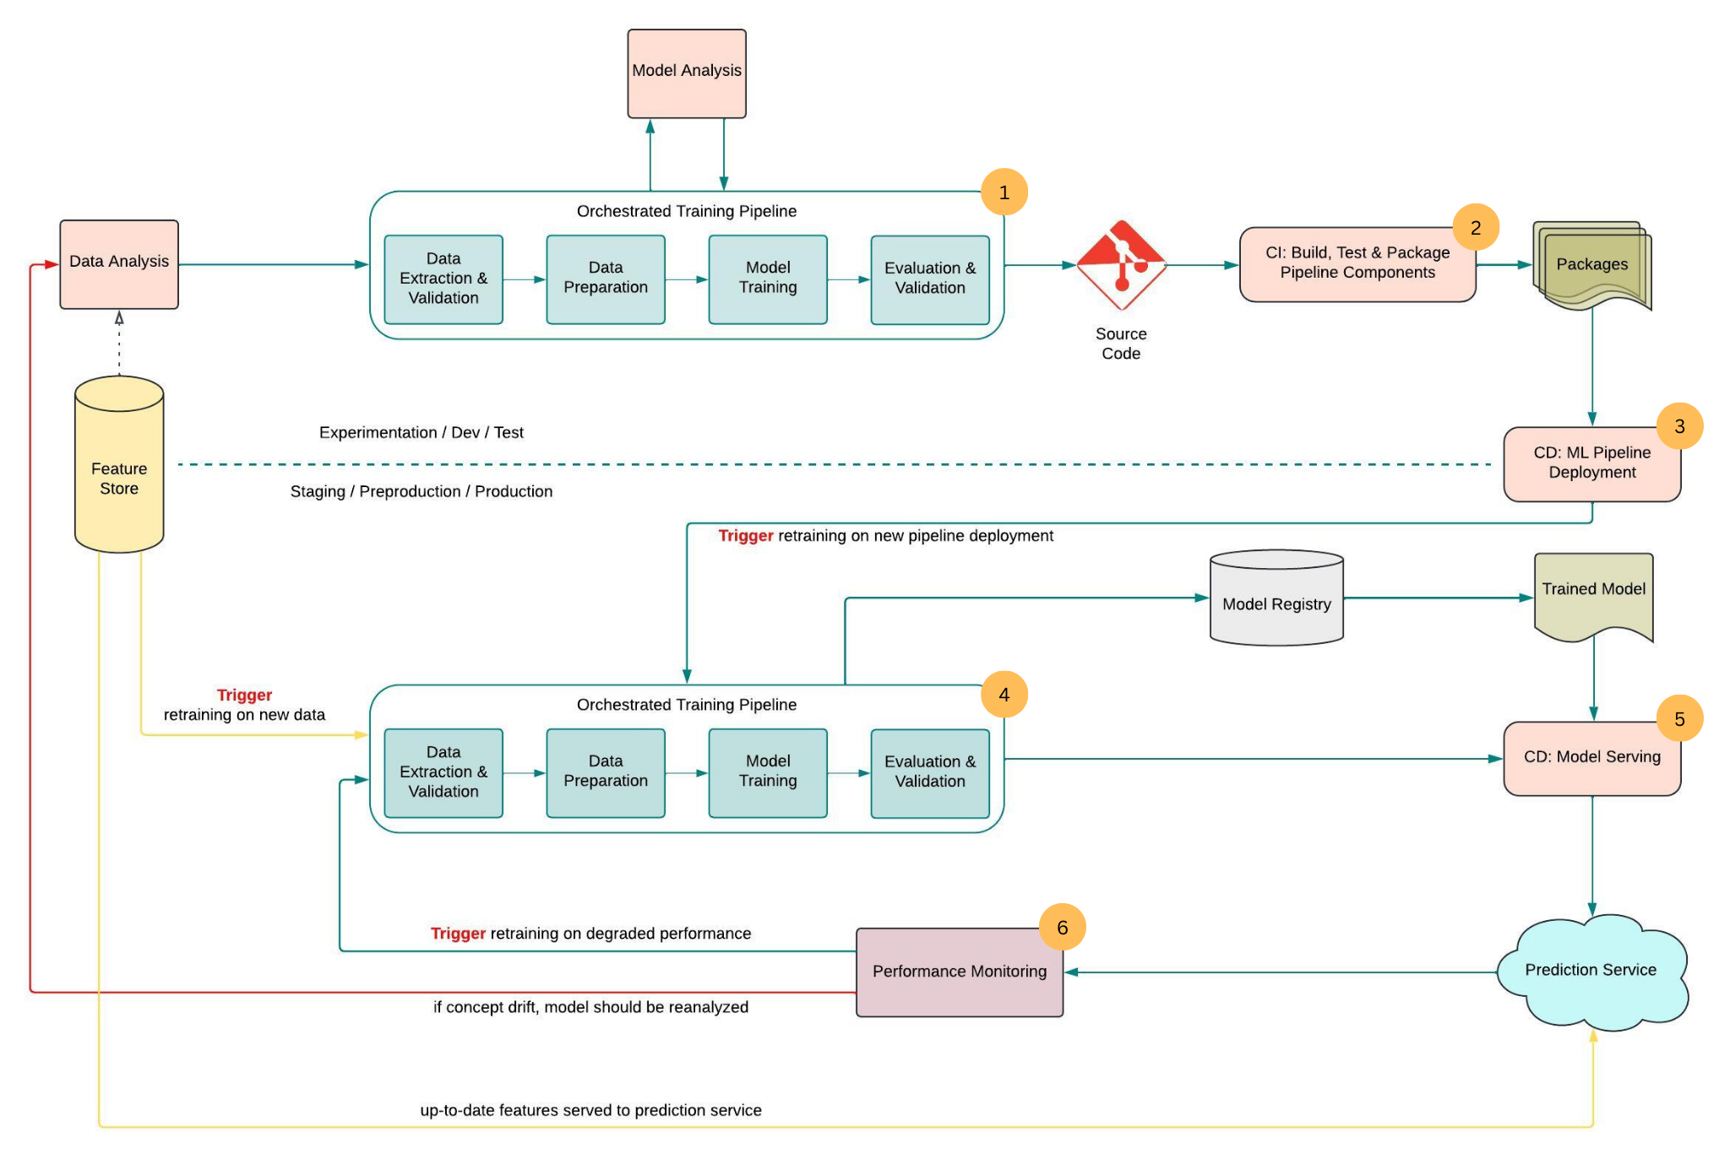

Slide 20
Any Questions ?

Slide 21
